Slide 1
EFFICIENT DATA RETRIEVAL FROM GRAPH DATABASE FOR MEDICAL APPLICATIONS
Guided by,
Dr. P. Jayashree,
Associate Professor
Team Members:
Arunkumar A R (2013503533)
Venkatesh S (2013503556)
Jayasurya K (2013503510)

Slide 2
Introduction
Data in various applications can be represented using graphs.
Some of them are chemical compounds, social networks, road networks etc.
Graph data models requires efficient graph data management techniques.
Various queries such as shortest path query, reachability query, sub graph query etc should be handled efficiently.

Slide 3
Why Graph Database?
A graph can serve as a general-purpose substrate for evaluating decision-making algorithms.
It is possible to intuitively represent relationship between any kinds of data.
Genomic and biological data are complex that can be represented as graphs.

Slide 4
Objective
To build an heuristic graph matching model to effectively find graph similarity in a graph databases

Slide 5
Problem Statement
Given a database consisting of n graphs where D={g1,g2,..gn} and a query graph ‘q’ .
Find all similar graphs with respect to the query graph.

Slide 6
Existing Method
Path based indexing is the existing and widely used method for indexing graph database.
It traverses all possible paths and then indexes the graph using hashing.

Slide 7
Proposed Novel method
We have proposed a structure based indexing approach.
It indexes based on the graph structure.
There will be large number of possible path available in path based indexing(existing).
In structure based using efficient pruning and retrieving the frequent fragments, it can be greatly reduced.

Slide 8
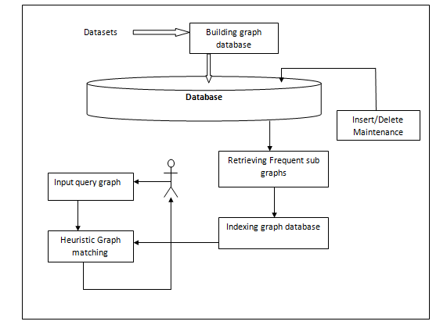
Architecture Diagram

Slide 9
Modules
Retrieving frequent sub graphs
Indexing graph database
Heuristic graph matching
Database maintenance

Slide 10
Retrieving frequent sub graphs
DFS coding is used as the input for generating the frequent sub graphs.
DFS coding is a set of vertices which is used for identifying the graphs.
It is of the format (x, y, L_{x,} L_{(x, y),}L_{y,})
x and y – vertex indices
L_{(x, y)} – Edge label
L_{x} and L_{y} – Label of the vertex x and y

Slide 11
Retrieving frequent sub graphs
Frequent sub graphs are those which are present in the graph database upto a given minimum support.
Frequent sub graph are generated by scanning the Graph database and finding all the edges that can be right most extended to frequent.
Then sorting all the frequent set in DFS lexicographical order.
This process is repeated for all the tuples identified in the frequent set.

Slide 12
Frequent fragment algorithm
Input: c = DFS code, G = graph database, s = min support
Output: F = Frequent sub graph set
Algorithm : frequent_subgraph(G, s, c, F)
Insert c into F
Set c to {}
Scan G once and find every edge e so that c can be right-most extended
If c can’t be extended return
Save c U e in c
Sort c in DFS lexicographical order
For each tuple in c
frequent_subgraph(G, s, c U e, F)

Slide 13
Indexing
Indexing of a graph database has to be done for efficient retrieval.
In this module, the graph database is indexed using the DFS code and the frequent fragments generated.
A prefix tree is built using both DFS code and frequent fragments.
Prefix tree allows user to check whether a fragment or a sub-graph of a query graph is present in the graph database efficiently

Slide 14
Indexing algorithm
Input: D-Graph database, F-Frequent Fragment
Output: Prefix Tree P
Algo: Indexing (F)
Initialize P with dummy node as root
For each dfscode in set F
P.Insert (dfscode, 0)
Input: dfscode - Array representing a graph
Algo: Insert (dfscode, position)
If position == len (dfscode) return
If dfscode [position] does not exists in P
Add current dfscode in P
Insert (dfscode, position +1)

Slide 15
Graph matching
In this module, the input query graph which is given by the user is compared efficiently with the graphs in the indexed graph database.
Graph matching can be done efficiently by eliminating (pruning) the redundant fragments.
If a fragment is not in the prefix tree, then its super-graph need not be compared.

Slide 16
Heuristic graph matching Algorithm
Input : D-graph database, q-query graph
Output : Result set R
Let R={}
For each fragment x where x is a sub graphof q and len(x) ≤ maxlen
If x is present in Prefix Tree then
R= R U x
return R

Slide 17
Database Maintenance
This module focus on Insertion and Deletion of new graphs which are added to the graph database lately.
We first generate DFS coding for those newly added graphs and find out the frequent subgraph.
This frequent set is added to the Prefix tree based on the frequency and size of each fragment in the frequent set.
For deletion operation the same strategy is followed .Find the level of the fragment set from the Prefix tree and remove the fragments from that level.

Slide 18
Database Maintenance
Input: Graph Database D, Frequent set F, Insert(delete) graph g and its id gid, Maximum fragment size maxL
Algo :
for each fragment x where x is a sub graph of g and len(x) <= maxL do
If x ϵ F then
Insert:
Insert gid into the id list of x
Delete:
Delete gid from the id list of x
return;

Slide 19

Implementation of proposed system
The database contains a set of graphs which is represented by a set of vertices and edges.
Sample graph is of the form

Slide 20
Implementation (contd..)
t #1 is the indicator which denotes the separation of two graphs. It also tells the starting of a new graph which is used for the creation of the graph
v x l_x - v denotes a new vertex with vertex id as x and the vertex label as l_x.
e u v l_uv - e denotes a new edge which connects the vertex u and v and has the label as l_uv

Slide 21
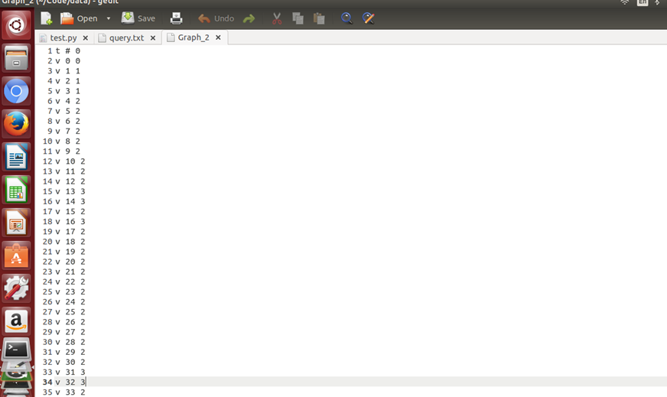
Sample Input Database

Slide 22
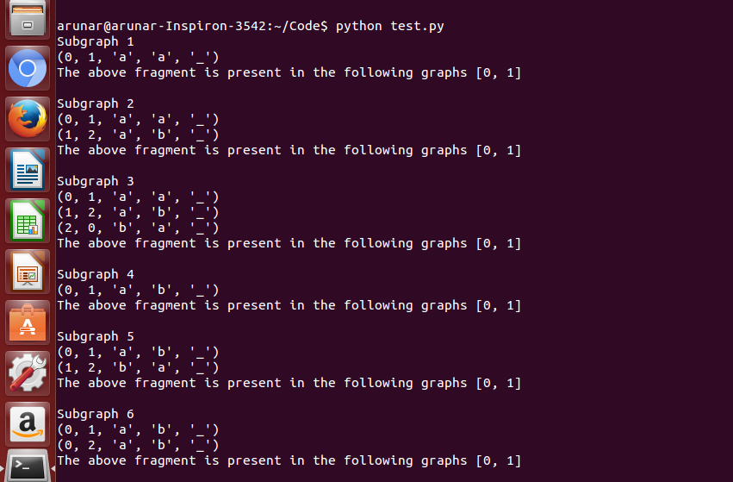
Output of frequent fragment algo

Slide 23
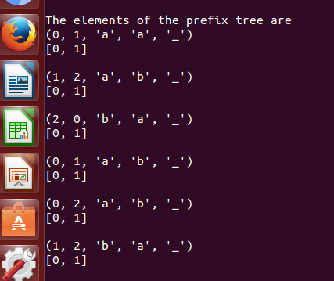
Elements of the prefix tree

Slide 24
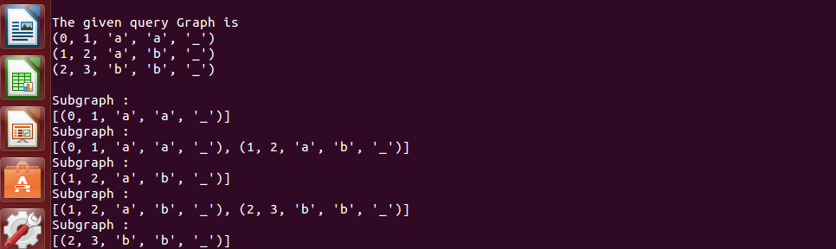
Sub graphs of query graph

Slide 25
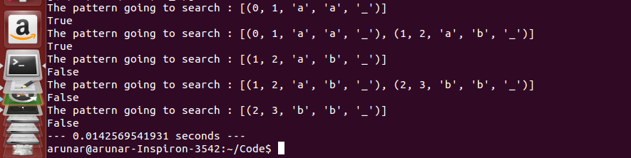
Searching the query graph

Slide 26
Complexity analysis
For retrieving frequent fragments : O (X * V³)
X- number of one edge fragment
V- number of vertices
For building the prefix tree : O (N * E)
N- Number of graphs in frequent set
E- Number of edges
Searching
To generate all subgraphs of a graph
For complete graphs : O (2^{N})
For not complete graphs : O (V * (V + E)) which is O (V²)
V- number of vertices
E- number of edges

Slide 27
Complexity analysis(contd..)
For Quering : O (E) where E is the number of edges in the graph.
Database maintenance : O (E) where E is the number of edges in the graph.

Slide 28
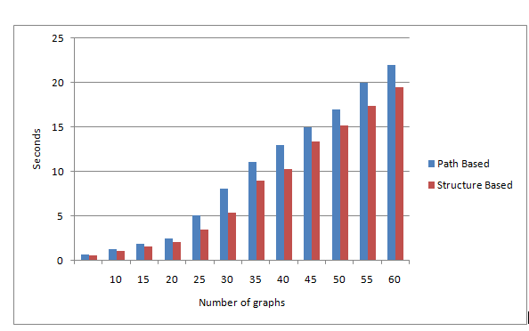
Comparitive Analysis of existing and proposed method

Slide 29
Conclusion
Graph similarity search is one of the important problems in recent times.
Existing classical algorithms for graph similarity are NP complete.
Results shows that runtime complexity of our proposed method structure based indexing outperforms existing path based approach .
It is done by pruning strategy and efficient searching of query graph.

Slide 30
References
[1] W. Zheng, L. Zou, X. Lian, D. Wang and D. Zhao, "Efficient Graph Similarity Search Over Large Graph Databases," IEEE Transactions on Knowledge and Data Engineering, vol. 27, no. 4, pp. 964-978, April 1 2015.
[2] E. S. S. Dongoran, W. K. Rahmat Saleh and A. A. Gozali, "Analysis and implementation of graph indexing for graph database using GraphGrep algorithm," ,3rd International Conference on Information and Communication Technology (ICoICT ), Nusa Dua, pp. 59-64, 2015.

Slide 31
References(contd..)
[3] Xifeng Yan Philip S. Yu, Jiawei Han " Graph Indexing: A Frequent Structure­based Approach," IEEE International Conference on Big Data, vol., no.4, pp.271,280, 2014.
[4] K. Gouda and M. Hassaan, "CSI_GED: An efficient approach for graph edit similarity computation," 32nd IEEE International Conference on Data Engineering (ICDE), Helsinki, pp. 265-276, 2016.

Slide 32
References(contd..)
[5] G. Wang, B. Wang, X. Yang and G. Yu, "Efficiently Indexing Large Sparse Graphs for Similarity Search," IEEE Transactions on Knowledge and Data Engineering, vol.24, no.3, pp.440-451, March 2012.
[6] L. Hong, L. Zou, X. Lian and P. S. Yu, "Subgraph Matching with Set Similarity in a Large Graph Database," IEEE Transactions on Knowledge and Data Engineering, vol. 27, no. 9, pp. 2507-2521, Sept1 2015.

Slide 33
References(contd..)
[7] Patil, Shefali, Vaswani, Gaurav; Bhatia, Anuradha , “Graph Databases- An Overview”, International Journal of Computer Science & Information Technology ,Vol. 5 Issue 1, p657, 2014.
[8] Xiaoli Wang, Xiaofeng Ding, Anthony K.H. Tung, ”An Efficient Graph Indexing Method”, a technical report, School of Computer Science, Huazhong University of Science and Technology, P. R. China, pp. 456-901, 2010.

Slide 34
References(contd..)
[9] L.Zou, J.Mo, L.Chen, M.T. Ozsu and D. Zhao, “gStore: Answering SPARQL queries via subgraph matching,” Proc. VLDB Endowment, vol. 4, no. 8, pp. 482–493, 2011.
[10] S. Zhang, J.Yang, and W. Jin, “Sapper: Subgraph indexing and approximate matching in large graphs,” Proc. VLDB Endowment, vol. 3, no. 1, pp. 1185–1194, 2010.

